Slide 1
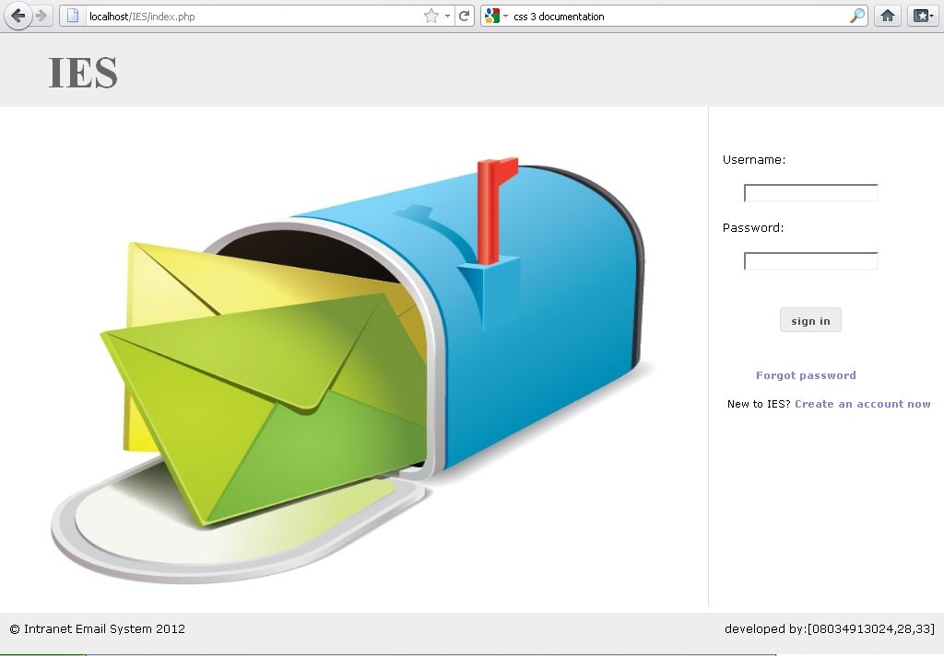
The Login

Slide 2
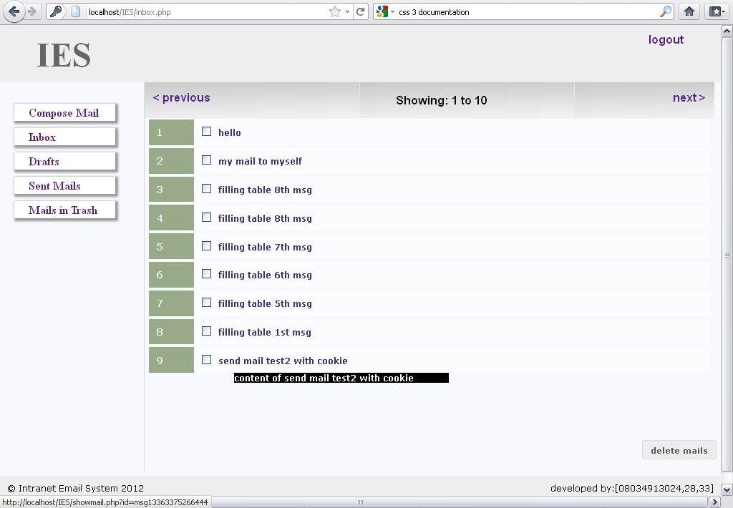
The Inbox
From : user1234
From : user1234
From : user1234
From : user1234
From : user1234
From : user1234
From : user1234
From : user1234
From : user1234

Slide 3
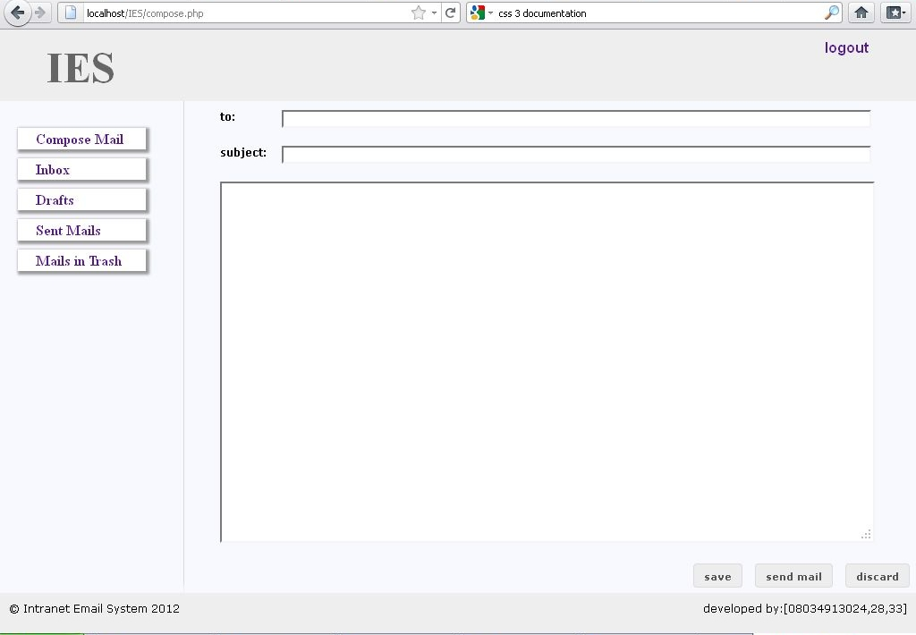
The compose page

Slide 4
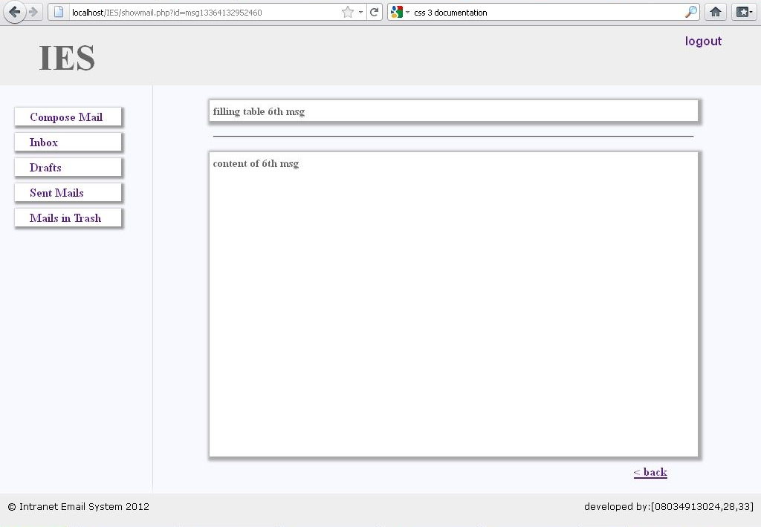
Viewing a Mail
From : user1234

